Slide 1
The First Step
Learning objectives
At the end of this lecture you should be able to:
explain the meaning of the word software;
describe the way in which software is produced in industry;
explain the need for high level programming languages;
describe the way in which programs are compiled and run;
distinguish between compilation and interpretation;
explain how Java programs are compiled and executed;
write Java programs that display text on the screen.
https://docs.oracle.com/javase/tutorial/java/

Slide 2
Software
a set of instructions given to a computer is called a program;
It is a sequence of separate commands one after the other.
With programming you are giving directions to the computer.
Software is the name given to a single program or a set of programs.

Slide 3
Programming
is the ability to take an idea in your head – break it apart into it’s individual pieces and know how to write these pieces into the programming language you are using at the time – writing your statements in the right order using the right syntax

Slide 4
Application software
is the name given to useful programs that a user might need;
for example
word-processors;
spreadsheets;
accounts programs.

Slide 5
System software
is the name given to special programs that help the computer to do its job
for example
operating systems such as UNIX or Windows;
network software.

Slide 6
Developing software: the traditional approach
Analysis and Specification
Design
Implementation
Testing
Installation
Operation and Maintenance

Slide 7
Developing software: the modern approach (RAD)
(rapid application development)
Analysis
Building
Prototypes
Initial
Planning
Final
Product
Testing and Quality Assurance
Reviewing
Prototypes

Slide 8
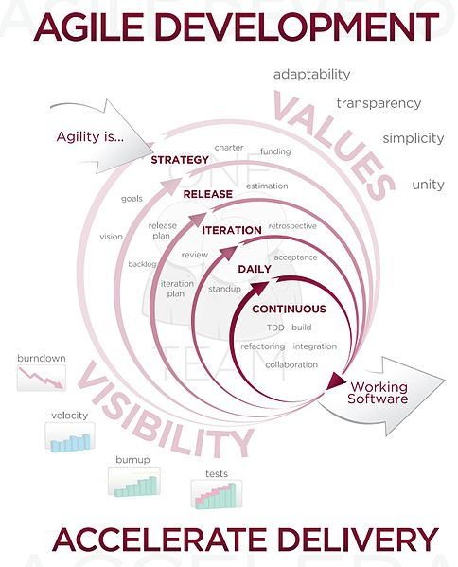
Developing software: Agile software development

Slide 9
Programming Languages
A program is written by a developer in a special computer language.
For example
C++;
Java;
BASIC;
Pascal.
Python
It is then translated by a special program (a compiler) into:
machine code,
or
Java byte code.

Slide 10
History of programming languages
Assembly language (low-level language)
High-level languages (third generation languages or 3GLs)
Examples
C
COBOL
BASIC
Pascal
Object-oriented programming languages
Examples
C++;
Java.

Slide 11
The traditional way of compiling programs
Source code
compiler
Object code
Linker
Executable
Program
Loader
Running program
Libraries and
other pre-compiled components
Edit and debug

Slide 12
Compilers and Interpreters
Compilers
operate on the entire program;
provide a permanent binary file which may be executed (or run).
Interpreters
translate and execute the program one line at a time.

Slide 13
Basic Program Development
Edit and
save program
errors
errors
Compile program
Execute program and
evaluate results

Slide 14
Compiling, interpreting and running Java Programs
Java interpreter
or JVM
Source code
Java interpreter
or JVM
Source code
Java byte code
Java compiler
Java byte code
Java compiler
Running program
Running program
Libraries
Libraries
Edit and debug
The jre is installed on each device and this interprets the java byte codes.
The jre contains the interpreter and generates local machine code.
This is what makes java multiplatform.

Slide 15
A typical Java Environment (Part 1 of 2)
Program is created in
Editor Disk the editor and stored
on disk.
Compiler creates
Compiler Disk bytecodes and stores
them on disk.
Primary
Memory
Class Loader Class Loader puts
bytecodes in memory
Disk

Slide 16
A typical Java Environment (Part 2 of 2)
Primary
Memory
Bytecode Verifier Bytecode Verifier confirms
that all bytecodes are valid and do not violate Java’s security restrictions
Primary
Memory
Interpreter Interpreter reads bytecodes and translates them into a language that the computer can understand, possibly storing data values as the program executes
Bytecode verifier is part of the jre.

Slide 17
Language Levels
There are four programming language levels:
machine language
assembly language
high-level language
fourth-generation language
Each type of CPU has its own specific machine language
The other levels were created to make it easier for a human being to read and write programs

Slide 18
Programming Languages
Each type of CPU executes only a particular machine language
A program must be translated into machine language before it can be executed
A compiler is a software tool which translates source code into a specific target language
Often, that target language is the machine language for a particular CPU type
The Java approach is somewhat different

Slide 19
Java Translation
The Java compiler translates Java source code into a special representation called bytecode
Java bytecode is not the machine language for any traditional CPU
Another software tool, called an interpreter, translates bytecode into machine language and executes it
Therefore the Java compiler is not tied to any particular machine
Java is considered to be architecture-neutral

Slide 20
Java Translation
Java source
code
Java
bytecode
Java
compiler
Bytecode
interpreter
Bytecode
compiler
Machine
code

Slide 21
class Hello
{
public static void main(String[] args)
{
System.out.print("Hello world");
}
}
System is a predefined final class, out is a PrintStream Object and println is a built-in overloaded method in the out object.
Program

Slide 22
Introduction to Java

Slide 23
History of Java
1991 “The Green Project” was created by Sun - Portable
Originally named “OAK” renamed to Java in 1995 (Public)
Write once / Run anywhere
Java Development Kit (JDK)
2010 Oracle buys Sun
J2SE7 = Java Platform, Standard Edition version 7
I’m now using jdk1.8.0_25 use the latest stable version.

Slide 24
The 5 principles of Java
Simple, object-oriented, and familiar
no deviations – c-style language, focuses design on the data (=objects) and on the interfaces to it.
Robust and secure
Java is intended for writing programs that must be reliable in a variety of ways. Java puts a lot of emphasis on early checking for possible problems, later dynamic (runtime) checking, and eliminating situations that are error prone.
Architecture-neutral and portable
High performance multi-threaded, dynamic – can change data types at runtime – fast
Interpreted – byte code not machine code.
Compiled to a format interpretative at runtime

Slide 25
Program Development
The mechanics of developing a program include several activities
writing the program in a specific programming language (such as Java)
translating the program into a form that the computer can execute
investigating and fixing various types of errors that can occur
Software tools can be used to help with all parts of this process

Slide 26
Syntax and Semantics
The syntax rules of a language define how we can put together symbols, reserved words, and identifiers to make a valid program
The semantics of a program statement define what that statement means (its purpose or role in a program)
A program that is syntactically correct is not necessarily logically (semantically) correct
A program will always do what we tell it to do, not what we meant to tell it to do

Slide 27
Errors
A program can have three types of errors
The compiler will find syntax errors and other basic problems (compile-time errors)
If compile-time errors exist, an executable version of the program is not created
A problem can occur during program execution, such as trying to divide by zero, which causes a program to terminate abnormally (run-time errors)
A program may run, but produce incorrect results, perhaps using an incorrect formula (logical errors)

Slide 28
Problem Solving
The purpose of writing a program is to solve a problem
Solving a problem consists of multiple activities:
Understand the problem
Design a solution
Consider alternatives and refine the solution
Implement the solution
Test the solution
These activities are not purely linear – they overlap and interact

Slide 29
Problem Solving
The key to designing a solution is breaking it down into manageable pieces
When writing software, we design separate pieces that are responsible for certain parts of the solution
An object-oriented approach lends itself to this kind of solution decomposition
We will dissect our solutions into pieces called objects and classes

Slide 30
Object-Oriented Programming
Java is an object-oriented programming language
As the term implies, an object is a fundamental entity in a Java program
Objects can be used effectively to represent real-world entities
For instance, an object might represent a particular employee in a company
Each employee object handles the processing and data management related to that employee

Slide 31
Objects
An object has:
state - descriptive characteristics
behaviors - what it can do (or what can be done to it)
The state of a bank account includes its current balance
The behaviors associated with a bank account include the ability to make deposits and withdrawals
Note that the behavior of an object might change its state

Slide 32
Classes
An object is defined by a class
A class is the blueprint of an object
The class uses methods to define the behaviors of the object
The class that contains the main method of a Java program represents the entire program
A class represents a concept, and an object represents the embodiment of that concept
Multiple objects can be created from the same class

Slide 33
UML Diagrams
The name of the class goes in this box
The attributes of the class are listed in this box
The methods of the class are listed in this box

Slide 34
Objects and Classes
A class
(the concept)
An object
(the realization)
Bank Account
John’s Bank Account
Balance: $5,257
Bill’s Bank Account
Balance: $1,245,069
Multiple objects
from the same class
Mary’s Bank Account
Balance: $16,833

Slide 35
Inheritance
One class can be used to derive another via inheritance
Classes can be organized into hierarchies
Account
Charge Account
Bank Account
Savings Account
Checking Account

Slide 36
We use Java because it is
- object-oriented - small & beautiful - extendible
- robust - concurrent - C/C++ syntax
- general-purpose - platform-independent -secure
- internet support - fun!
The main components of a Java program are classes (objects) , variables, parameters and methods.
A method is similar to a procedure or function in C.
Each method has a given identity or “signature”.

Slide 37
For each method we know its signature by
- method name
- how many parameters
- in what order
- what type of data each must be
E.g. credit check requires, say,
- 2 parameters
- the first must be a customer object
- the second must be an amount of money
Messages that don’t match signatures are erroneous.

Slide 38
Now lets consider an object A that sends a message to object B. A wants B to perform a particular action.
In sequential execution,
- B executes the requested behaviour
- meanwhile, A waits (doing nothing)
- when B finishes, A resumes
In concurrent execution A continues with other work while B is executing the method.
Some methods produce a result that they return to the invoking object
_ E.g. my tea brewing method returns a cup of tea object

Slide 39
Other methods do not return a result.
To understand a method, we will want to know its name, what it does, its signature and what type of data is returned (if any).
The signature plus the type of data it returns is sometimes called the method’s prototype.
Java programs give an abstract idea of the way the world works: objects (having state & behaviour) get things done by invoking the behaviour of other objects.
A Java program when it runs will be exactly like this: objects (having instance variables & methods) will be created and will get things done by invoking the methods of other objects.
Notes:
Java. In the Java programming language, a method signature is the method name and the number, type and order of its parameters. Return types and thrown exceptions are not considered to be a part of themethod signature.

Slide 40
Most of the text of the Java application itself will be taken up with definitions of the objects
In other words, as a text, a Java application is a collection of class definitions; when it is executed, it creates a collection of communicating objects.

Slide 41
Development Environments
There are many programs that support the development of Java software, including:
Sun Java Development Kit (JDK)
Sun NetBeans
IBM Eclipse
Borland JBuilder
MetroWerks CodeWarrior
Monash BlueJ
Though the details of these environments differ, the basic compilation and execution process is essentially the same

Slide 42
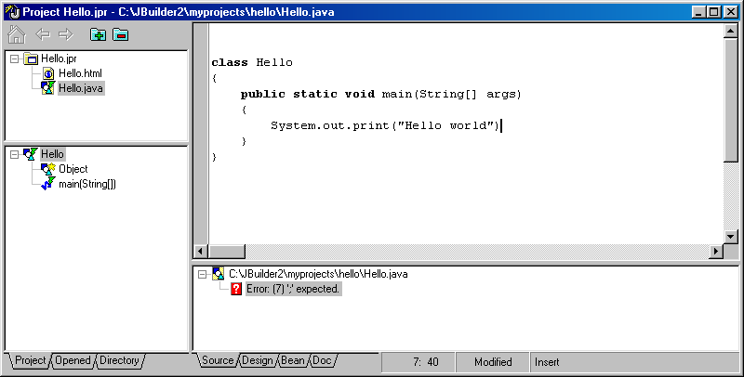
A typical Java IDE

Slide 43
Arithmetic Operations in Java
Java Arithmetic Algebraic Java
Operation operator expression expression
Addition + f+7 f + 7
Subtraction - p-c p – c
Multiplication * bm b * m
Division / x/y or x or x y x / y
y
Modulus % r mod s r % s

Slide 44
Precedence of arithmetic operators
Operator(s) Operation(s) Order of evaluation(precedence
( ) Parentheses Evaluated first. If the parentheses are nested, the expression in the innermost pair is evaluated first.. If there are several pairs of parentheses “on the same level” (I. E., not nested), they are evaluated left to right.
*, / or % Multiplication Evaluated second. If there are several, Division they are evaluated left to right.
Modulus
+ or - Addition Evaluated last. If there are several, Subtraction they are evaluated left to right.

Slide 45
Equality and relational operations
Standard algebraic Java equality Example
Equality operator or or relational of Java Meaning of
Relational operator operator condition Java condition
Equal operators
= = x = y x is equal to y
= != x != y x is not equal to y
Relational operators
> > x > y x is greater than y
< < x < y x is less than y
> >= x >= y x is greater than or equal to y
< <= x <= y x is less than or equal to y

